Slide 1
FY24 Development Dashboard – July 1, 2023– June 30, 2024 Analysis
YEAR OVER YEAR PUBLIC SUPPORT
TOTAL PUBLIC SUPPORT
SUSTAINERS HARVEST
MONTHLY GIVING
NUMBER OF DONORS
NUMBER OF NEW DONORS
NUMBER OF GIFTS
FY22
21,256
FY22
3,364
FY22
49,597
 | Number Donors | Monthly Revenue | Average Gift
Jun. 2022 | 821 | $35,976 | $43.82
Jun. 2023 | 994 | $44,616 | $44.89
Jun. 2024 | 1,027 | $46,812 | $45.58
FY23
18,724
FY23
2,589
FY23
45,273
FY24
18,453
FY24
3,296
FY24
44,926
OVERALL DONOR RETENTION
STRATEGIC PLAN METRIC:
MAJOR DONOR RETENTION
PUBLIC SUPPORT BREAKDOWN
RETENTION OF $5K CUMULATIVE DONORS FY23 – FY24
MAJOR DONOR REVENUE
3%
Goal: 86% Retention
$7,348,087
6%
347 | $5,000+ Cumulative Donors in FY23
299 | $5,000+ Donors Retained in FY24
86% | Retention Rate
$6,870,981
14%
61%
$5,000+
$6,507,785
427 Gifts
418 Gifts
406 Gifts
16%
FY22
FY23
FY24
STRATEGIC PLAN METRIC: INCREASE ONLINE GIFTS
Individuals
$7,200,683 (61%)
Organization Grants
$1,912,623 (16%)
Organizations
$1,616,576 (14%)
Capital Grants & Bequests
$761,268 (6%)
Special Events
$307,159 (3%)
Goal: Increase from 17% to 20% of Total Giving
$1,930,953
FY22
Offline: 78%
Online: 22%
FY23
Offline: 77%
Online: 23%
FY24
Offline: 78%
Online: 22%
$1,000 to
$4,999.99
$1,831,345
$1,800,675
1,197
Gifts
1,102
Gifts
1,143
Gifts
Based on number of individual gifts. Does not include Monthly Sustainers.
FY22
FY23
FY24

Slide 2
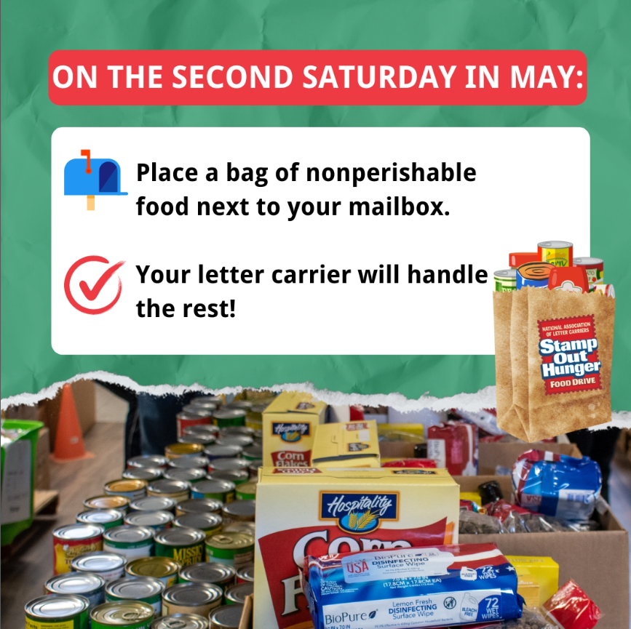
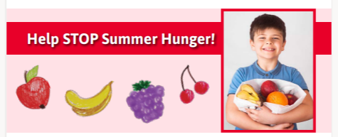
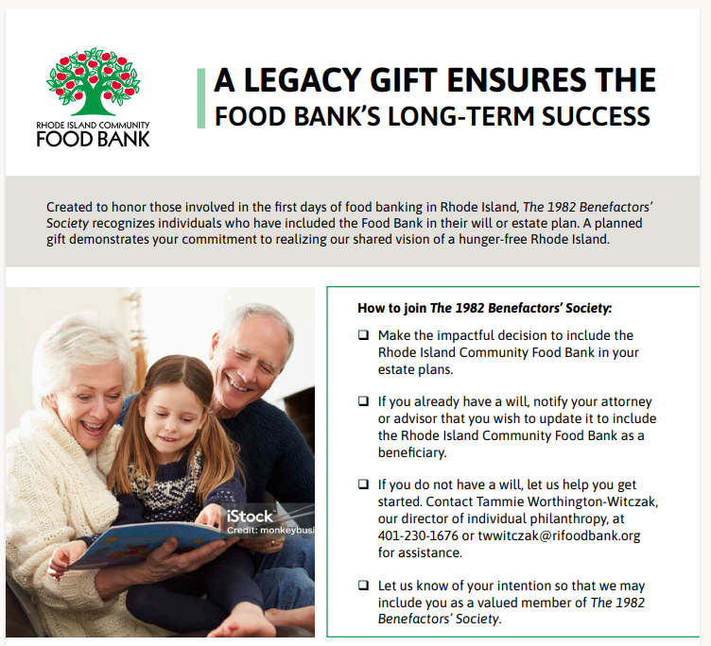
FY24 Communications Dashboard – Quarter 4 Analysis: April - June
EMAIL MARKETING
WEBSITE PAGE VIEW COMPARISON:
Q3 FY24 VS Q4 FY24
USERS BY WEB TRAFFIC SOURCE
29,186
Subscribers as of April 16, 2024
(up 2% Q over Q)
15
Emails sent from
April - June
Paid Search: 55,644
TOP PAGES (Apr - Jun)
Donate Landing Page
Home Page
Find Food
Agency Portal
166,974
Organic: 6,332
Appeal
9 Emails
37% Avg Open
0.67% Avg Click
Cultivation
6 Emails
33% Avg Open
0.98% Avg Click
151,765
Direct: 6,219
60%
40%
9%
Jan-Mar
Apr-Jun
Email: 1,922
Industry Avg is 25% Open / 2% Clicks
Total page view number includes multiple visits to the same page by the same person.
Referral: 1,188
STRATEGIC PLAN METRIC: GROWTH IN SOCIAL FOLLOWERS
SOCIAL POST IMPRESSIONS
SHARING OUR MESSAGE
Baseline Followers:
End of FY21
FY2024
Growth GOAL
Actual Growth from
FY22 to Current
Number of Followers
To Date (7/1/24)
Post Impressions describes on average, how many people have seen or interacted with our posts – a better indicator of engagement with our content.
Speaking | Media | Events
1
17
3
 | 10,238 | 15% | 10% | 11,224
 | 3,061 | 30% | 32% | 4,035
 | 7,980 | 3.5% | -2% | 7,821
 | 1,389 | 20% | 70% | 2,361
 | 55 | YouTube not a strategic plan metric | 265% | 201
Speaking Engagements Around Hunger
Students: URI Tour
Media Coverage
ABC6, WPRI, PBN, Newsweek, local papers, covering:
Schiff op-ed, Donations, SNAP benefits and general hunger topics
Events
Friends of the Food Bank Breakfast
Letter Carriers’ Food Drive
Rhody Regatta
150,246
331% from the prior 90 days
3,672
-51% from the prior 90 days
4,236
-8% from the prior 90 days
5,406
1% from the prior 90 days

